Slide 1
Empirical Distributions
In data science, the word "empirical" means "observed". Empirical distributions are
distributions of observed data, such as data in random samples.
Ref: Lab Ex for details

Slide 2
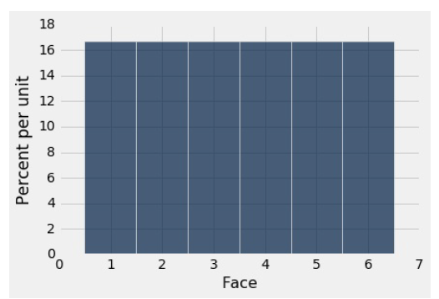
A Probability Distribution
Expt – throwing a dice
The histogram below helps us visualize the fact that every face appears with probability 1/6.
We say that the histogram shows the distribution of probabilities over all the possible faces.
Since all the bars represent the same percent chance, the distribution is called uniform on the integers 1 through 6.

Slide 3
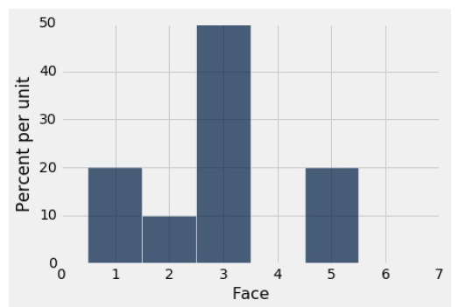
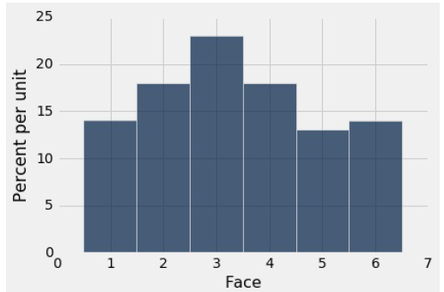
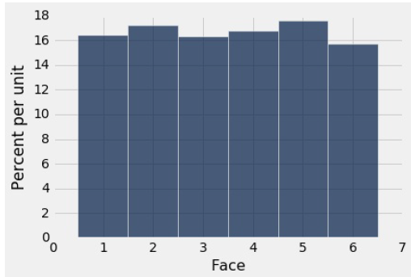
Empirical Distributions
The distribution stated earlier consists of the theoretical probability of each face. It is not based on data. It can be studied and understood without any dice being rolled.
Empirical distributions, on the other hand, are distributions of observed data. They can be visualized by empirical histograms.
Analyse by simulating rolls of a die. This can be done by sampling at random with replacement from the integers 1 through 6… use np.random.choice .
Empirical histogram of 10, 100 and 1000 rolls

Slide 4
The Law of Averages
If a chance experiment is repeated independently and under identical conditions, then, in the long run, the proportion of times that an event occurs gets closer and closer to the theoretical probability of the event.
For example, in the long run, the proportion of times the face with four spots appears gets closer and closer to 1/6.
Here "independently and under identical conditions" means that every repetition is performed in the same way regardless of the results of all the other repetitions

Slide 5
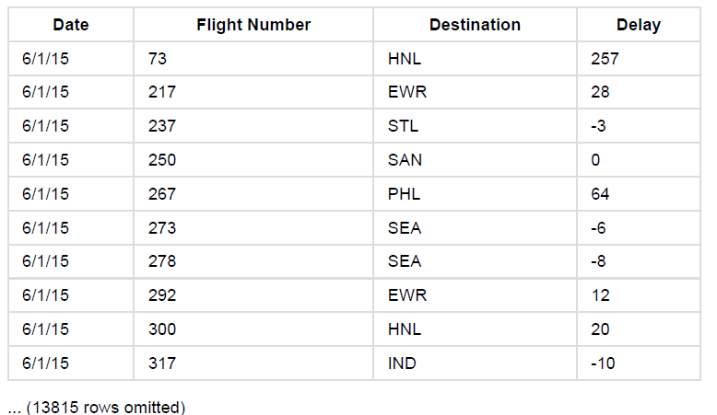
Sampling from a Population
The law of averages also holds when the random sample is drawn from individuals in a large population.
As an example, study a population of flight delay times.
Data: United Airlines domestic flights departing from San Francisco in the summer of 2015. The data are made publicly available by the Bureau of Transportation Statistics in the United States Department of Transportation.
There are 13,825 rows, each corresponding to a flight. The columns are the date of the flight, the flight number, the destination airport code, and the departure delay time in minutes.
Some delay times are negative; those flights left early.

Slide 6
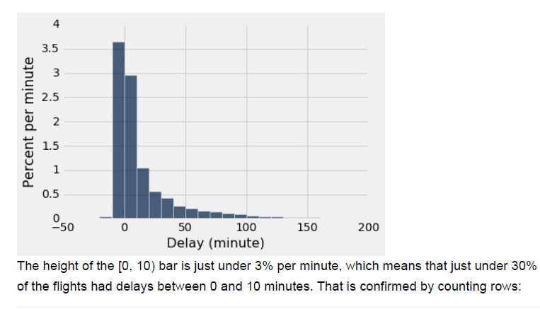
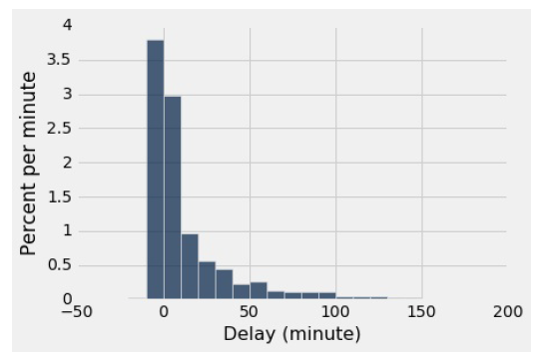
Histogram of delays : Population Vs Sample
Population | Sample
Convergence of the Empirical Histogram of the Sample
Observation: For a large random sample, the empirical histogram of the sample resembles the histogram of the population, with high probability.
This justifies the use of large random samples in statistical inference.
The idea is that since a large random sample is likely to resemble the population from which it is drawn, quantities computed from the values in the sample are likely to be close to the corresponding quantities in the population.

Slide 7
Population Parameter Vs Statistic
Parameter
Numerical quantities associated with a population are called parameters. For the population of flights in United , the value of the parameter "median delay": 2secs
Statistic
In many situations, we will be interested in figuring out the value of an unknown parameter.
For this, rely on data from a large random sample from the population.
A statistic (note the singular!) is any number computed using the data in a sample.
Note the observed value of the sample median.
Simulate the statistic many times and note the values. A histogram of those values gives the distribution of the statistic.

Slide 8
Simulating a Statistic
Simulate the sample median using the 4 steps
Step 1: Decide which statistic to simulate. the median of a random sample of size 1000 drawn from the population of flight delays.
Step 2: Write the code to generate one value of the statistic. Draw a random sample of size 1000 and compute the median of the sample.
Step 3: Decide how many simulated values to generate. eg do 5,000 repetitions.
Step 4: Write the code to generate an array of simulated values.
As in all simulations, start by creating an empty array in which results are collected.
set up a loop for generating all the simulated values.
The body of the loop will consist of generating one simulated value of the sample median, and appending it to the collection array.
5000 repetitions of the process of drawing a sample of size 1000 and computing its median.

Slide 9
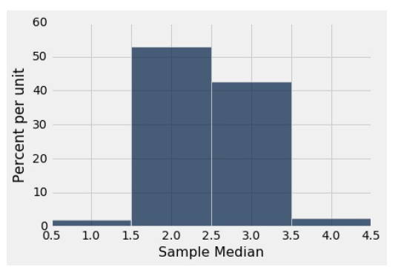
Empirical Distribution of the Statistic –random sample of 1000 flights
The sample median is very likely to be close to 2, which was the value of the population median.
Since samples of 1000 flight delays are likely to resemble the population of delays, it is not surprising that the median delays of those samples should be close to the median delay in the population.
This is an example of how a statistic can provide a good estimate of a parameter.

Slide 10
The Power of Simulation
If we could generate all possible random samples of size 1000 => would know all possible values of the statistic (the sample median), as well as the probabilities of all those values.
Visualize all the values and probabilities in the probability histogram of the statistic.
But in many situations (including this one), the number of all possible samples is large enough to exceed the capacity of the computer, and purely mathematical calculations of the probabilities can be intractably difficult.
This is where empirical histograms come in.
By the Law of Averages, the empirical histogram of the statistic is likely to resemble the probability histogram of the statistic, if the sample size is large and if you repeat the sampling process numerous times.
This means that simulating random processes repeatedly is a way of approximating probability distributions without figuring out the probabilities mathematically or generating all possible random samples.
Thus computer simulations become a powerful tool in data science. They can help data scientists understand the properties of random quantities that would be complicated to analyze in other ways.

Slide 11
Lab

